Slide 1
Drosophila lab-II
Supplemental lecture
11-3-16

Slide 2
Chapter 5 – Linkage/Crossing over/ Chromosome mapping
We have spent much time studying one or a small number of genes contributing to specific traits:
  e.g. Isoagglutinogen gene---blood type

Slide 3
Of course each of our genes is located on a specific chromosome with many other genes physically linked to the same chromosome.

Slide 4
Who first described linkage…
Thomas Morgan---X-linked genes (white eye mutation).

Slide 5
Human chromosomes
23 different chromosomes
  Human Genome Project sequenced each of them. Estimate ~20,000-30,000 protein coding genes
  Average ~1300 genes/chromosome

Slide 6
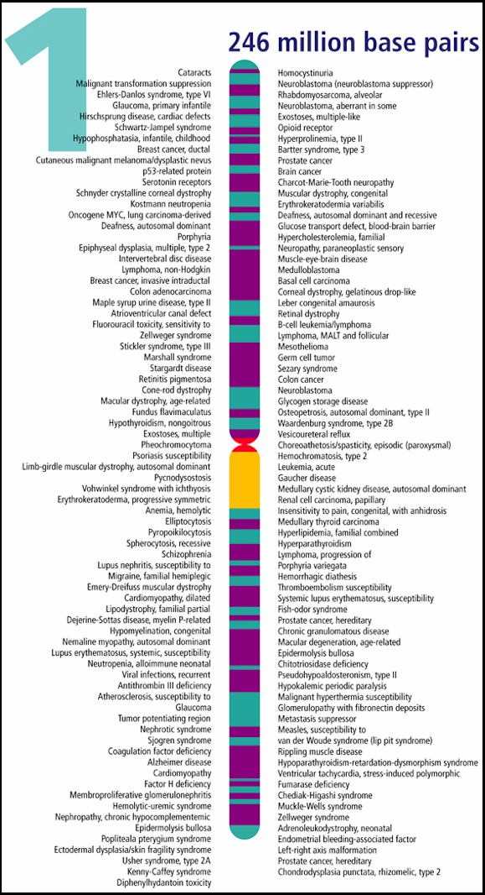
Example---genes mapped to chromosome 1

Slide 7
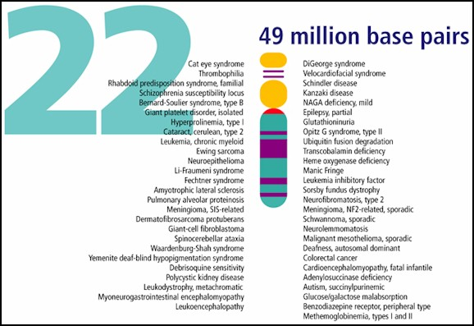
Genes mapped to human chromosome 22

Slide 8
Let’s begin by comparing independently assorting genes with linked genes
  Familiar example: color and texture in corn kernels
  Yellow (aa) sweet (bb)
  vs vs.
  Purple (A_) Starchy (B_)

Slide 9
In our lab we assumed 2 unlinked genes controlled these 2 traits
F2 offspring showed classic ratio of independent assortment
9 A_B_ Purple/starchy
3 A_bb Purple /sweet
3 aaB_ yellow/starchy
1 aabb yellow/sweet

Slide 10
What if the A locus and B locus were on the same chromosome. What do you expect?
--on white board…

Slide 11
What if the A locus and B locus were on the same chromosome. What do you expect?
--on white board…Do cross of a heterozygote AaBb X AaBb
A
a
A
a
B
b
B
b

Slide 12
This is an example of complete linkage.
  Complete linkage is actually quite rare---Why?
    During gamete formation, alleles on homologous chromosomes can switch places during crossing over / recombination. In a sense 2 alleles can become separated from each other, but not by independently assorting.

Slide 13
Review figure 5-2 for a case of complete linkage in Drosophila.
They show the results of a testcross with 2 linked genes.

Slide 14
Visualize what occurs during crossing over.
  F1 heterozygote
  on board….

Slide 15
Thomas Morgan (remember him?) and his student, Alfred Sturtevant, were the first to really describe crossing over when while studying X-linked genes.

Slide 16
Morgan looked at X-linked genes 2 at a time.
e.g. yellow body and white eyes
white eyes and miniature
…Sound familiar?......

Slide 17
Noted they appeared to be unlinked some of the time, forming new combinations in a small proportion F2 offspring.
e.g. in crosses analyzing yellow body and white eyes, about 0.5% of the offspring showed the y allele and the w allele apparently switching places during gamete formation.
(99.5% of the time the alleles did not swap places) (Figure 5-3)

Slide 18
Oddly, other pairs of X-linked genes recombined at different frequencies.
in crosses analyzing white eyes and miniature phenotype, about 34.5% of the offspring showed the w allele and the m allele apparently switching places during gamete formation.
(65.5% of the time the alleles did not switch) (Figure 5-3)

Slide 19
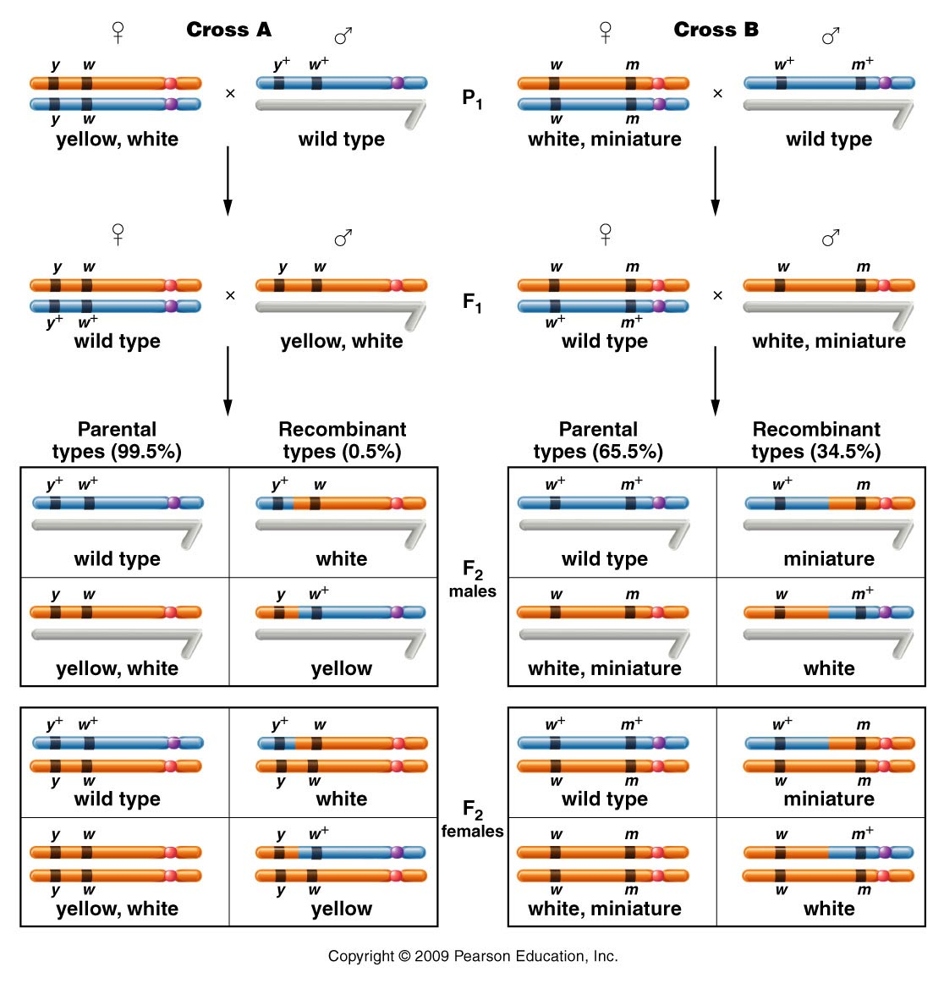
Figure 5.3
Notes:
19
Figure 5-3 The F1 and F2 results of crosses involving the yellow-body, white-eye mutations and the white-eye, miniature-wing mutations. In cross A, 1.3 percent of the F2 flies (males and females) demonstrate recombinant phenotypes, which express either white or yellow. In cross B, 37.2 percent of the F2 flies (males and females) demonstrate recombinant phenotypes, which are either miniature or white mutants.

Slide 20
Sturtevant’s conclusion:
1) linked genes do physically separate as a result of crossing over during meiosis
2) Different crossing over/recombination frequencies reflect physical distances between loci.
3) Closely spaced genes are less likely to undergo crossing over.

Slide 21
Distances determined by recombination frequencies are not actual physical distances, but do reflect relative distances between genes.
Units are centiMorgans (cM) or map units (mu)

Slide 22
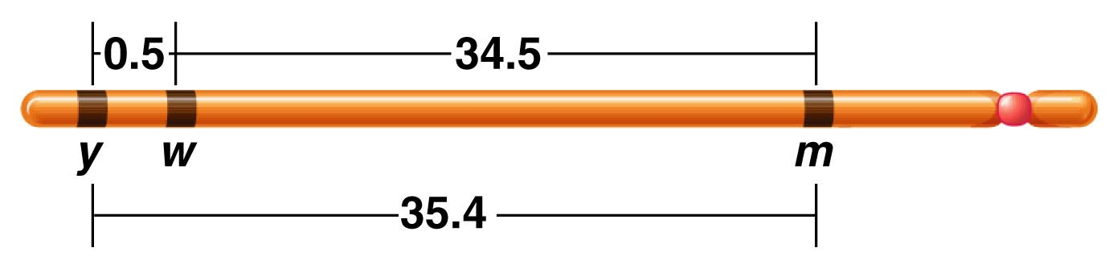
Morgan’s data was used to create a map showing the relative distance between the genes.
Aa
**The two, 2-point crosses would not show order, unless all combinations of genes were analyzed.
Figure 5.4
Notes:
Figure 5-4 A map of the yellow (y), white (w), and miniature (m) genes on the X chromosome of Drosophila melanogaster. Each number represents the percentage of recombinant offspring produced in one of three crosses, each involving two different genes.

Slide 23
Quick summary…linked genes
We’ve defined linked genes.
We’ve noted that independent assortment does not occur, with linked genes.
We’ve noted that linked alleles can separate if crossing over occurs between them.

Slide 24
Crossover occurs more frequently, the farther apart 2 genes are on the same chromosome.
A b C
a B c

Slide 25
The frequency in which crossover is noted, becomes a recombination gene distance (in cM or mu)
A b C
a B c
Might see recombinant offspring due to a-b crossover 2% of the time and b-c, 35 % of the time.

Slide 26
The frequency in which crossover is noted, becomes a recombination gene distance (in cM or mu)
A b C
a B c
Might see recombinant offspring due to a-b crossover 2% of the time and b-c, 35 % of the time.
2 cM
35 cM

Slide 27
Note---Crosses must be carefully designed to be able to observe crossing over. (X-linked traits simplify the analysis)
  1 parent must be heterozygous
  1 parent must provide only recessive alleles so that new combinations of wt/recessive traits are evident.

Slide 28
Heterozygous female
Male with only recessive alleles
Figure 5.3
Notes:
Figure 5-3 The F1 and F2 results of crosses involving the yellow-body, white-eye mutations and the white-eye, miniature-wing mutations. In cross A, 1.3 percent of the F2 flies (males and females) demonstrate recombinant phenotypes, which express either white or yellow. In cross B, 37.2 percent of the F2 flies (males and females) demonstrate recombinant phenotypes, which are either miniature or white mutants.

Slide 29
Morgan’s crosses were simplified in 2 ways:
  1. Using X-linked crosses in Drosophila meant that crossing over was only possible in females. (2 X chromosomes)
  2. In Drosophila, males do not engage in crossing over at all so looking at recombination of any linked genes is simplified.

Slide 30
Morgan’s student, Alfred Sturtevant saw an immediate application to recombination mapping.
  Determination of linear sequence of genes on a chromosome.

Slide 31
Sturtevant noted that recombination frequencies were approximately additive, allowing the order of genes to be determined.
In 3 separate crosses:
  y-w frequency is 0.5%
  w-m frequency is 34.5
  y-m frequency is 35.4 %

Slide 32
Sturtevant noted that recombination frequencies were approximately additive, allowing the order of genes to be determined.
In 3 separate crosses:
  y-w frequency is 0.5%
  w-m frequency is 34.5
  y-m frequency is 35.4 %
**Which genes are on the outside?
*** Which gene is in the middle?
****Which genes are closest to each other?

Slide 33
Sturtevant’s data was used to create a map showing the relative distance between the genes AND order.
Usually, the further 2 genes are spaced the less accurate recombination mapping becomes (explained later)
Figure 5.4
Notes:
Figure 5-4 A map of the yellow (y), white (w), and miniature (m) genes on the X chromosome of Drosophila melanogaster. Each number represents the percentage of recombinant offspring produced in one of three crosses, each involving two different genes.

